Slide 1
Adaptable Traffic Signal Control System
Guide: Dileep Kumar Koda M.Tech.,(Ph.D)

Slide 2
ABSTRACT
Adaptable traffic signal control system project is a software-based solution that is designed to manage the traffic signals at an intersection in a city. The system is intended to optimize traffic flow, reduce congestion, and improve overall safety. The project involves designing and developing a software system that is capable of monitoring traffic in real-time, controlling traffic signals based on vehicle density. The system will use a control algorithm to optimize the traffic signal timings, ensuring that traffic flows smoothly and efficiently. The system will collect and analyze data on traffic and this information will be used to adjust the traffic signal timings and the system will helps in reduce the wasting time. The system will also be able to integrate with other systems, such as traffic cameras to provide a comprehensive view of the traffic conditions. Overall, the traffic signal management system project aims to create a more efficient, safe, and reliable traffic management system that can help reduce traffic congestion.

Slide 3
Problem Statement
The problem we aim to address with our mini project is the inefficiency of traditional fixed-time traffic signal systems. These fixed-time systems allocate a fixed duration for each signal phase, regardless of the actual traffic conditions. As a result, significant traffic congestion and delays occur, leading to reduced efficiency, increased fuel consumption, and higher levels of pollution.
Our goal is to develop an Adaptive Signal Management System that dynamically adjusts signal durations based on real-time traffic conditions. The system will utilize vehicle detection techniques to accurately count the number of vehicles approaching each signal phase. By analyzing this data, the system will optimize signal timings to minimize congestion and maximize traffic flow efficiency.

Slide 4
Objective
An Adaptable traffic signal control system project is a software-based solution that is designed to manage the traffic signals at an intersection or a group of intersections in a city.
The system is intended to optimize traffic flow, reduce congestion, and improve overall safety.
System that is capable of monitoring traffic in real-time.
Setting up the traffic signal timing based on traffic flow and congestion.

Slide 5
Existed Systems To Manage Traffic
Manual Controlling
Equi Timer Controlling
Electronic Sensors

Slide 6
Drawbacks Of Existed Systems
Manual Controlling System requires large no.of manpower.
Static signal timing
Lack of coordination
Inability to adapt to changes
Starvation

Slide 7
Proposed System
Our proposed system aims to address the problem of unpredictable traffic flow and congestion caused by static signal timers.
By automatically computing the optimal green signal time based on current traffic conditions.
We will utilize cameras at traffic junctions to calculate real-time traffic density by detecting vehicles at signals, allowing us to adjust signal timings accordingly.

Slide 8
Advantages Of Proposed System
No need of manpower
Improved Traffic Flow
Reduced Congestion
Real-time Data Collection and Analysis
Real time traffic light switching according to traffic density
Flexibility and Adaptability
Integration with Emerging Technologies

Slide 9
Proposed System Model
Our proposed system will pass a snapshot from the CCTV cameras at the junction for real time traffic density calculation using image processing.
Algorithms Used:
YOLO(You Look Only Once) for object detection.
Scheduling Algorithms for signal switching.

Slide 10
Some Factors to be Considered
Vehicle detection should be done accurately
The processing time of algorithm to calculate traffic density.
The number of lanes
The maximum and minimum green signal time that can be set .This is done to prevent starvation of the lane with less traffic.

Slide 11
Proposed System Overview
Capturing images using CCTV installed at traffic signals
Detecting vehicles using image processing and calculating traffic density
Traffic density sent to server for calculating green signal time
Using this time scheduling is done
Traffic signal time is updated

Slide 12
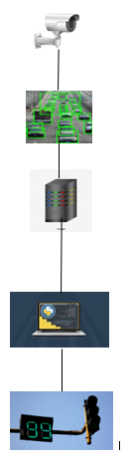
Capturing images
Vehicle detection
Traffic density send to server for calculating
green signal time
Using this time scheduling is done
Signal timer updated

Slide 13
You Only Look Once(YOLO)algorithm
The YOLO algorithm takes an image as input and then uses a simple deep convolutional neural network to detect objects in the image
It divides an image into the grid system and in that each grid detects objects within itself.
DNN architecture in yolo enables it to learn complex representations and patterns in the input data, allowing it to detect and classify objects accurately.

Slide 14
Modular Components
The system can be broken down into 3 modules:
Vehicle Detection module
Signal Timer Setting Module
Simulation module

Slide 15
Vehicle Detection Module
A custom YOLO model was trained on a dataset created by scraping images from Google and manually labelling them using LabelIMG.
The model was trained by adjusting the configuration of the .cfg file for the detection of different classes.
After training, the updated weights were imported into the code and integrated with the OpenCV library for vehicle detection.

Slide 16
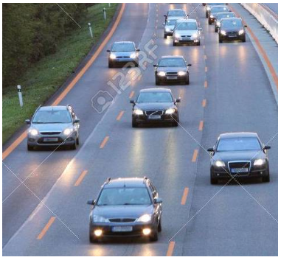
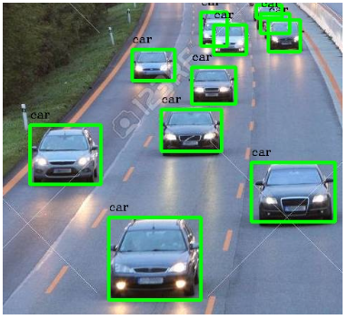
INPUT IMAGE OUTPUT IMAGE
VEHICLE COUNT:

Slide 17
The custom YOLO model trained for vehicle detection demonstrated accurate results and efficient processing time. By utilizing the OpenCV library and adjusting the model's configuration, the system successfully detected vehicles of various classes in real-time.

Slide 18
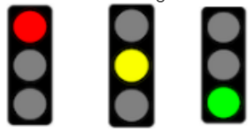
Traffic Signals
Red :It means that you must stop your vehicle and wait until the light turns green.
Yellow :It means that you should slow down and prepare to stop.
Green :It means that you may proceed through the intersection.

Slide 19
Signal timer setting module
The signal timer setting module takes the number of vehicles detected and sets the green signal timer accordingly . It also updates the red signal timers of other signals.
The algorithm is scalable to any number of signals and it can be used for any number of signals at an intersection.

Slide 20
Signal timer setting module Development
Factors to determine the green light duration:
The processing time of the algorithm
The number of lanes
The total number of vehicles
The traffic density
The lag time of vehicles
The average speed of vehicles
The minimum and maximum green light duration

Slide 21
Simulation Module
A Pygame-based traffic simulation was developed from scratch, featuring a 4-way intersection with traffic signals and vehicle movements.
A counter that displays the number of vehicles that have crossed the intersection.
It compares the existed and proposed system
A timer that shows the time remaining for the signal to switch colors .

Slide 22
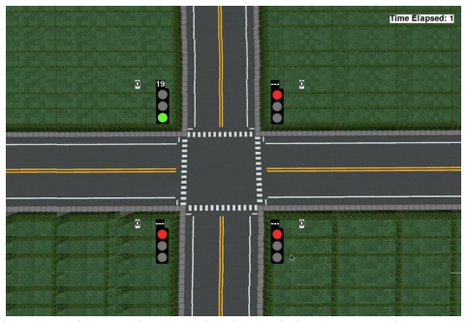
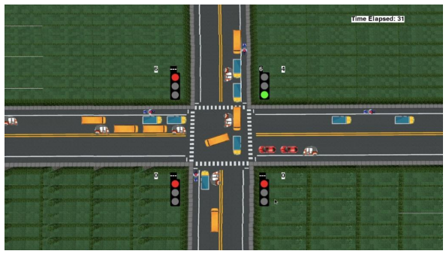
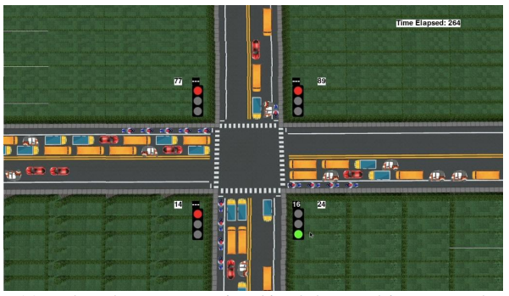

Slide 23
The signal switching algorithm and simulation module are effective tools for improving traffic flow . The algorithm can determine the optimal green light duration for each direction of traffic.
The simulation module can visualize the system and compare it to the existing static system . These tools can help to make traffic signals more efficient and effective.

Slide 24
Conclusion
The adaptive traffic signal control system is a smart and efficient solution for managing traffic flow at intersections. The existing traffic signal control systems have limitations in terms of responsiveness to changing traffic patterns, leading to congestion, delays, and accidents. The proposed adaptive traffic signal control system addresses these issues by using real-time data analysis, machine learning algorithms, and intelligent decision-making to optimize traffic flow.

Slide 25
THANK YOU
PRESENTED BY
K. SRILATHA
S. PUJITHA
B. SIVA JYOSHANA

